Slide 1
IS216 Web Application Development II
Week 4
JavaScript – Part 2 (DOM & Event Handling)
K. J. Shim
Sections: G3/G4

Slide 2
Source Code Files
eLearn → Content → Week 4 → In Class → Week4_InClass.zip
Unzip it into:
<WebRoot> → is216 → Week4 → InClass

Slide 3
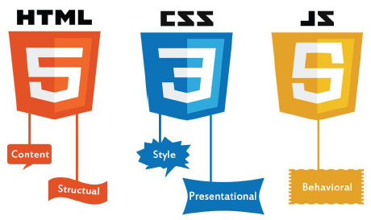
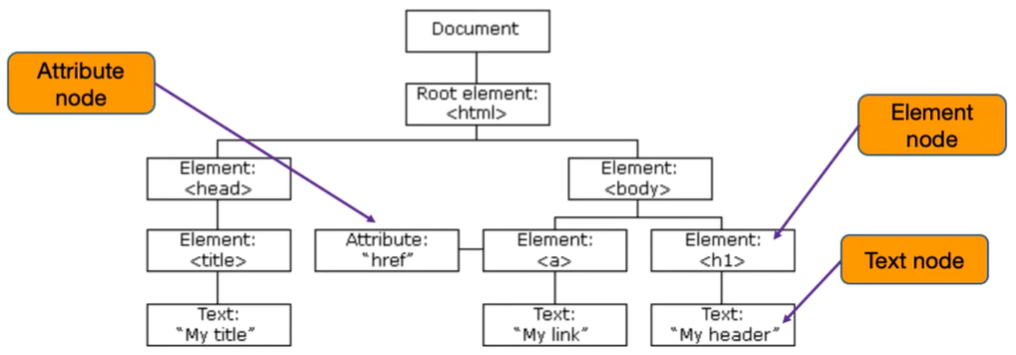
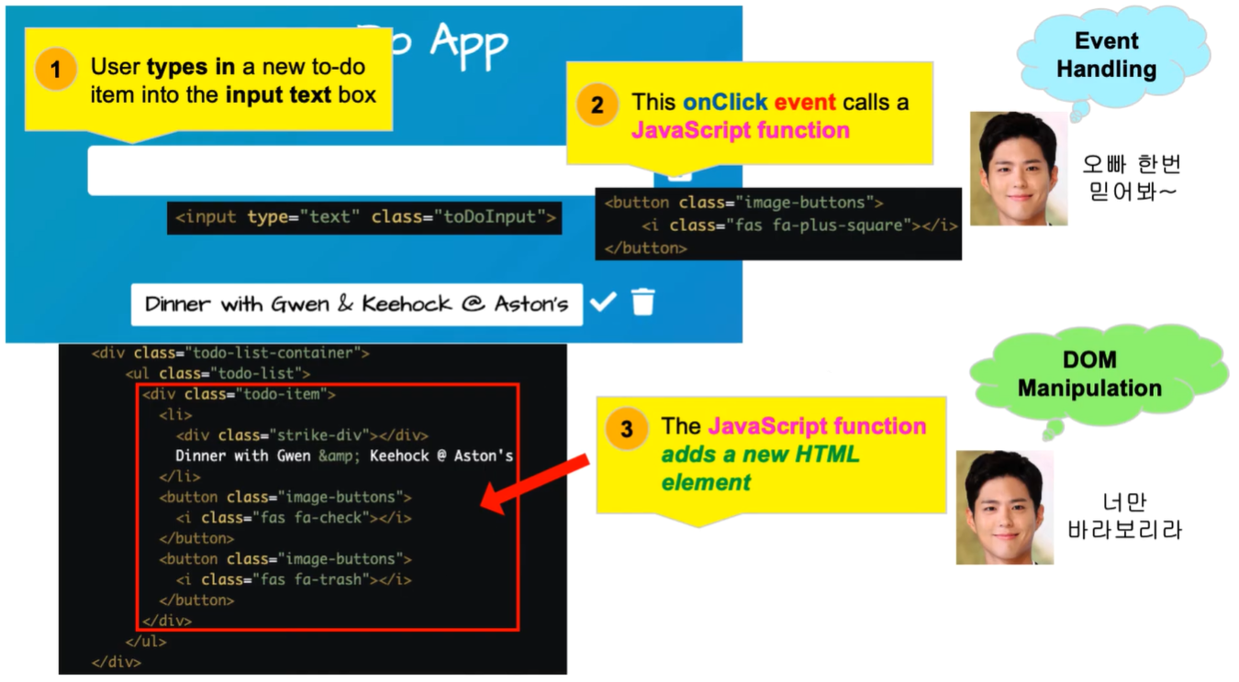
Agenda
Dynamic Web app “Whenever some event occurs, change the HTML document.”
Introduction to DOM
Event Handling – onclick event
Accessing HTML Elements
Accessing HTML Attributes
Modifying HTML
Adding and Removing HTML Elements
More event handling

Slide 4
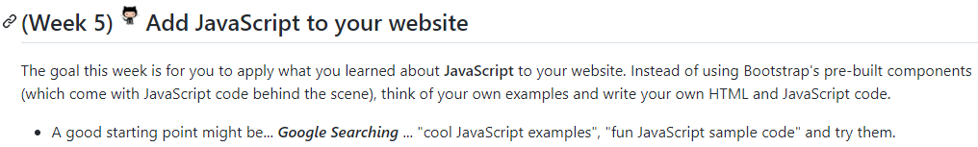
Things to Finish Before Week 5
Complete:
JavaScript – Part 2 (DOM & Event Handling) – Challenges 10, 11, 12
Resource files (Bootstrap 5.2 version !!!) can be downloaded from this link (please replace Bootstrap CSS/JavaScript CDN with the latest V5.3)
[GitHub Pages – Personal Website]
eLearn → Content → Week 5 → Before Class
Watch the video
Complete Week 5: Pre-Class Quiz (JavaScript – Part 3)
(Week 4)

Slide 5
Questions? Need Help?
Join us in Slack
@
https://is216-oppa.slack.com
Thank You!

